Slide 1

IDS-702 Final Project
Jeremy Zeng

Slide 2
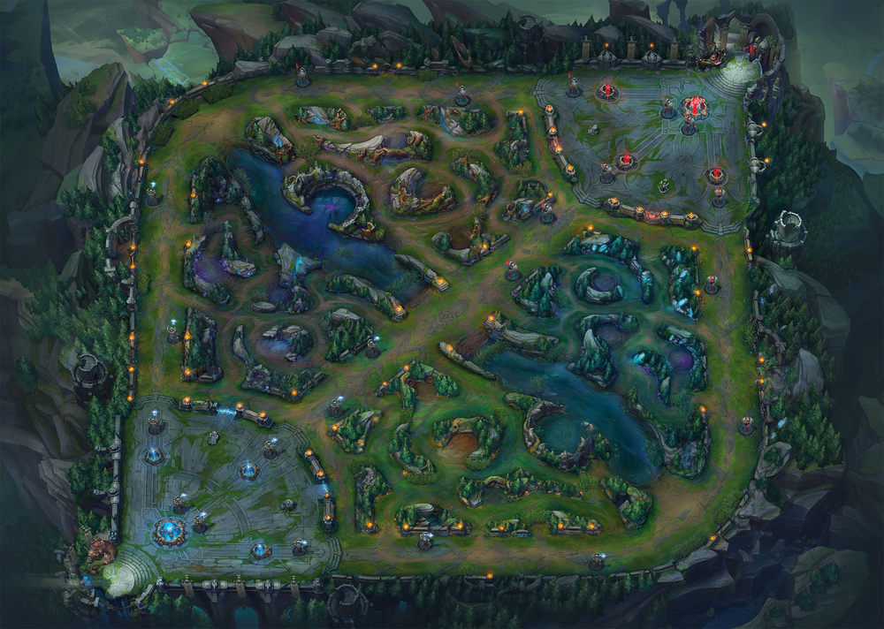
Key Research
Questions
Top
What factors affect the odds of winning for blue team?
Which role will influence the winning of the game most?
Does the effect of roles for winning the game differ from season?
Mid
Jungle
ADC & Support

Slide 3
Data
Response Variable
Win – 1 for Blue Win (Red Loss) ; 0 for Blue Loss (Red Win)
‘Role’Avg – Gold difference for different roles. (e.g. TopAvg, MidAvg)
If positive, blue team has advantage. If negative, red team has advantage.
Predictor Variables
KillDiff – Number of kills difference between blue and red teams.
If positive, blue team has advantage. If negative, red team has advantage.
GameLength – How long the game last. (In minute)
7620 Obs.
Season – Factor variable w/ 5 levels (2014-2018 seasons)
……

Slide 4
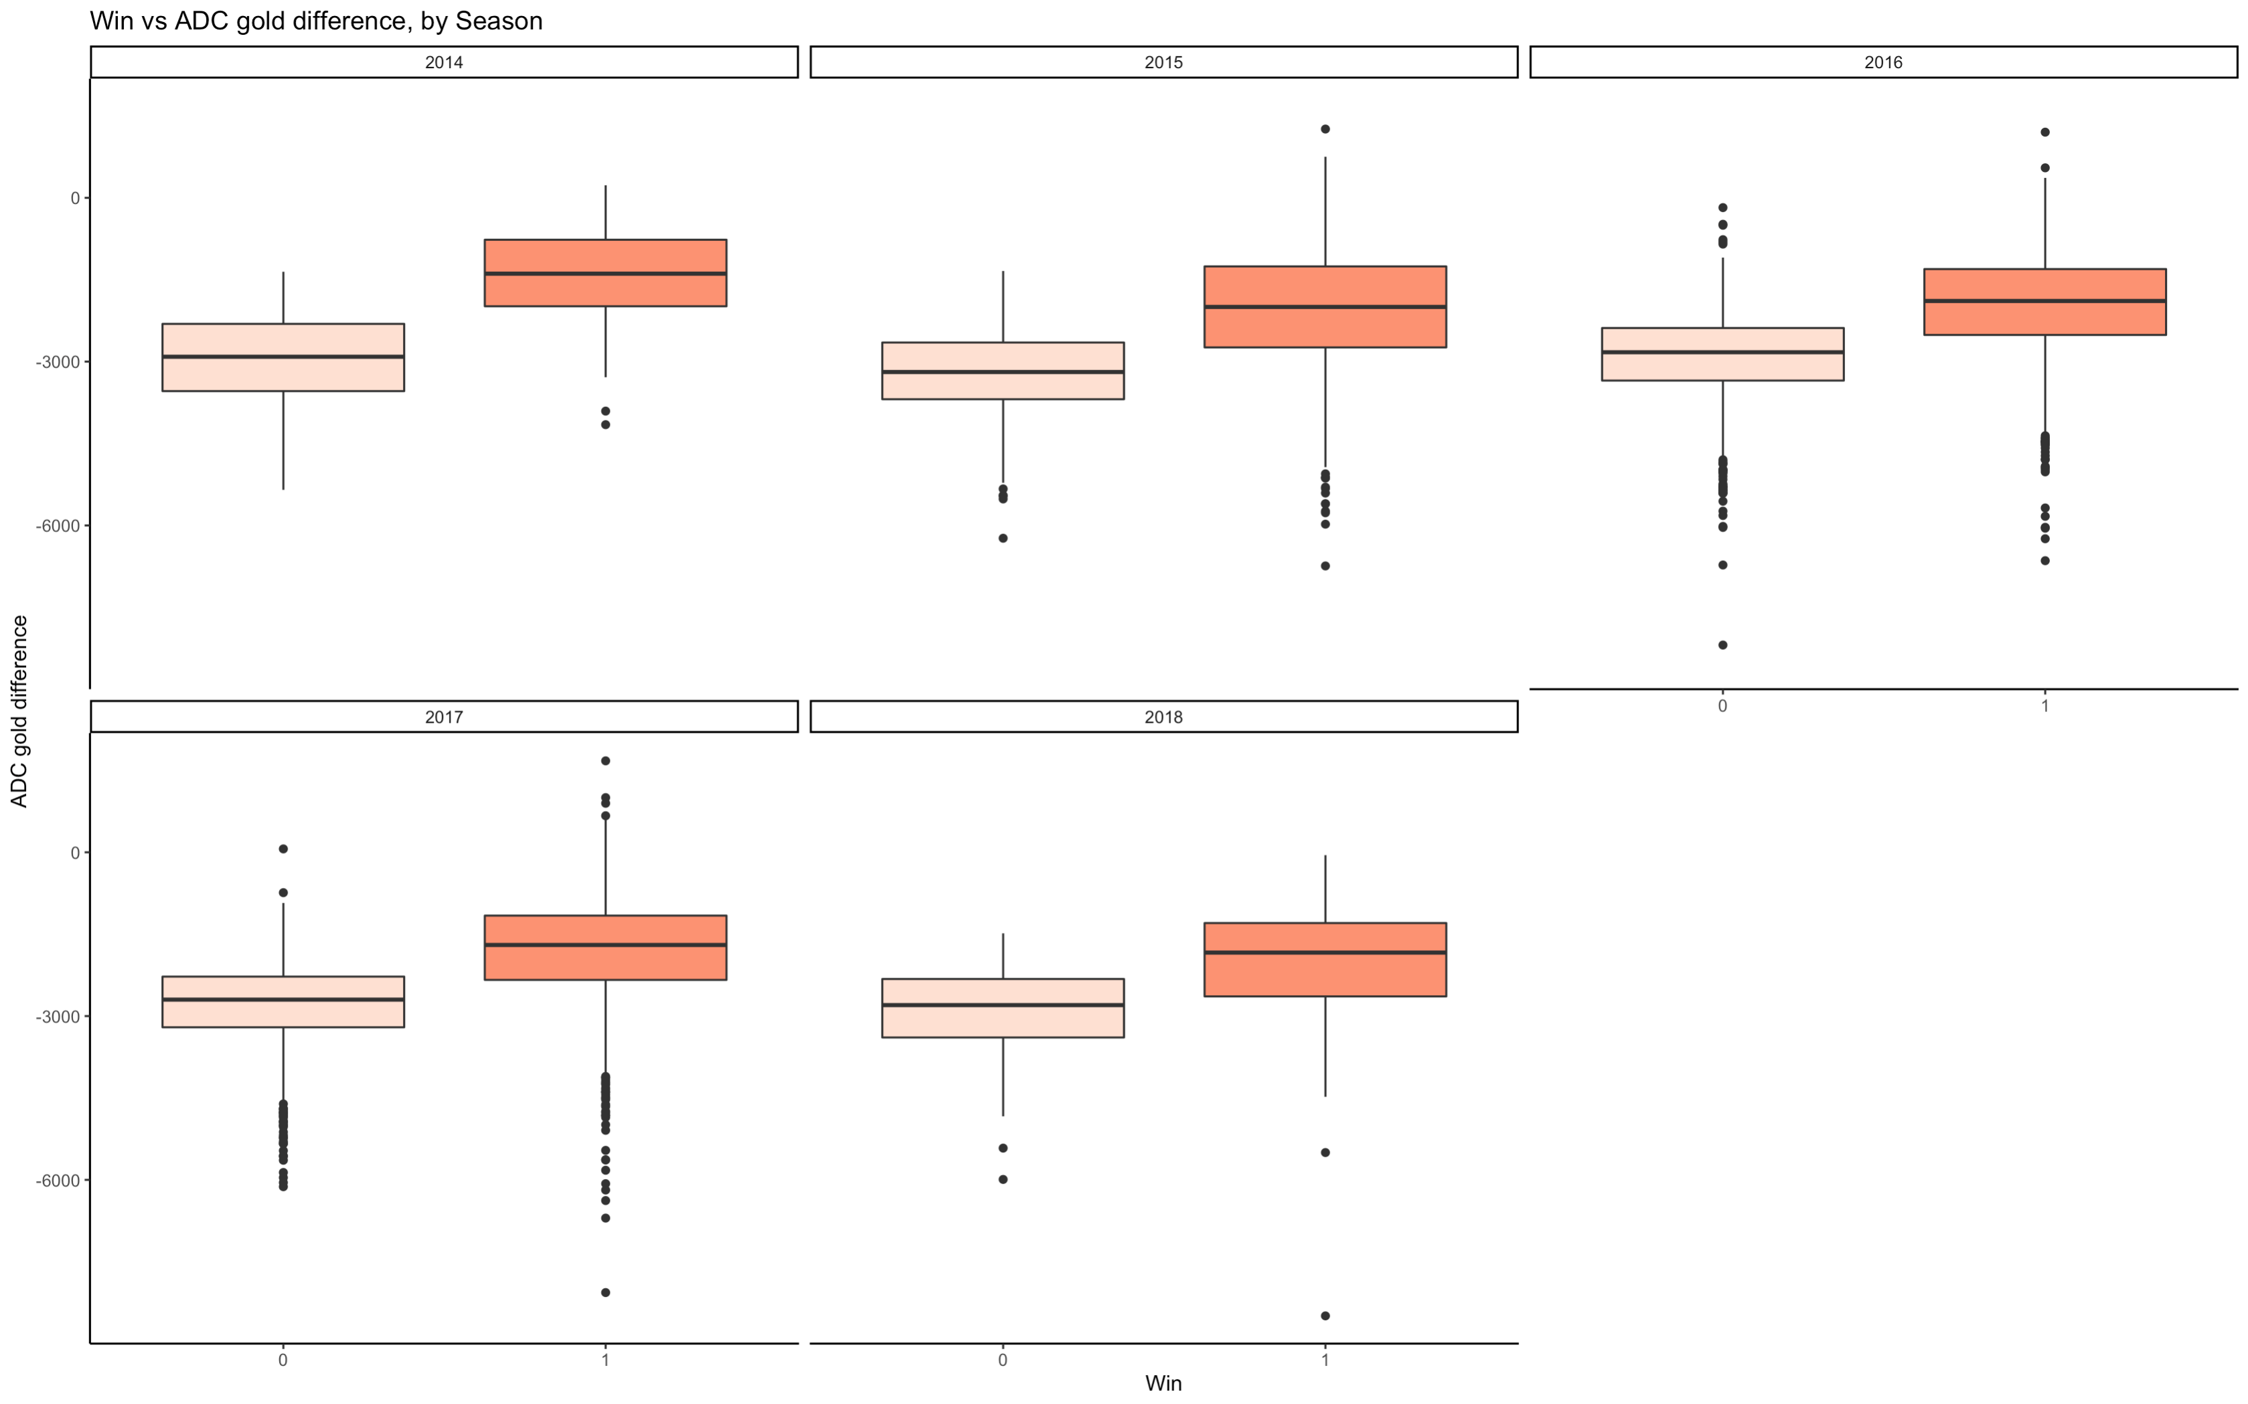
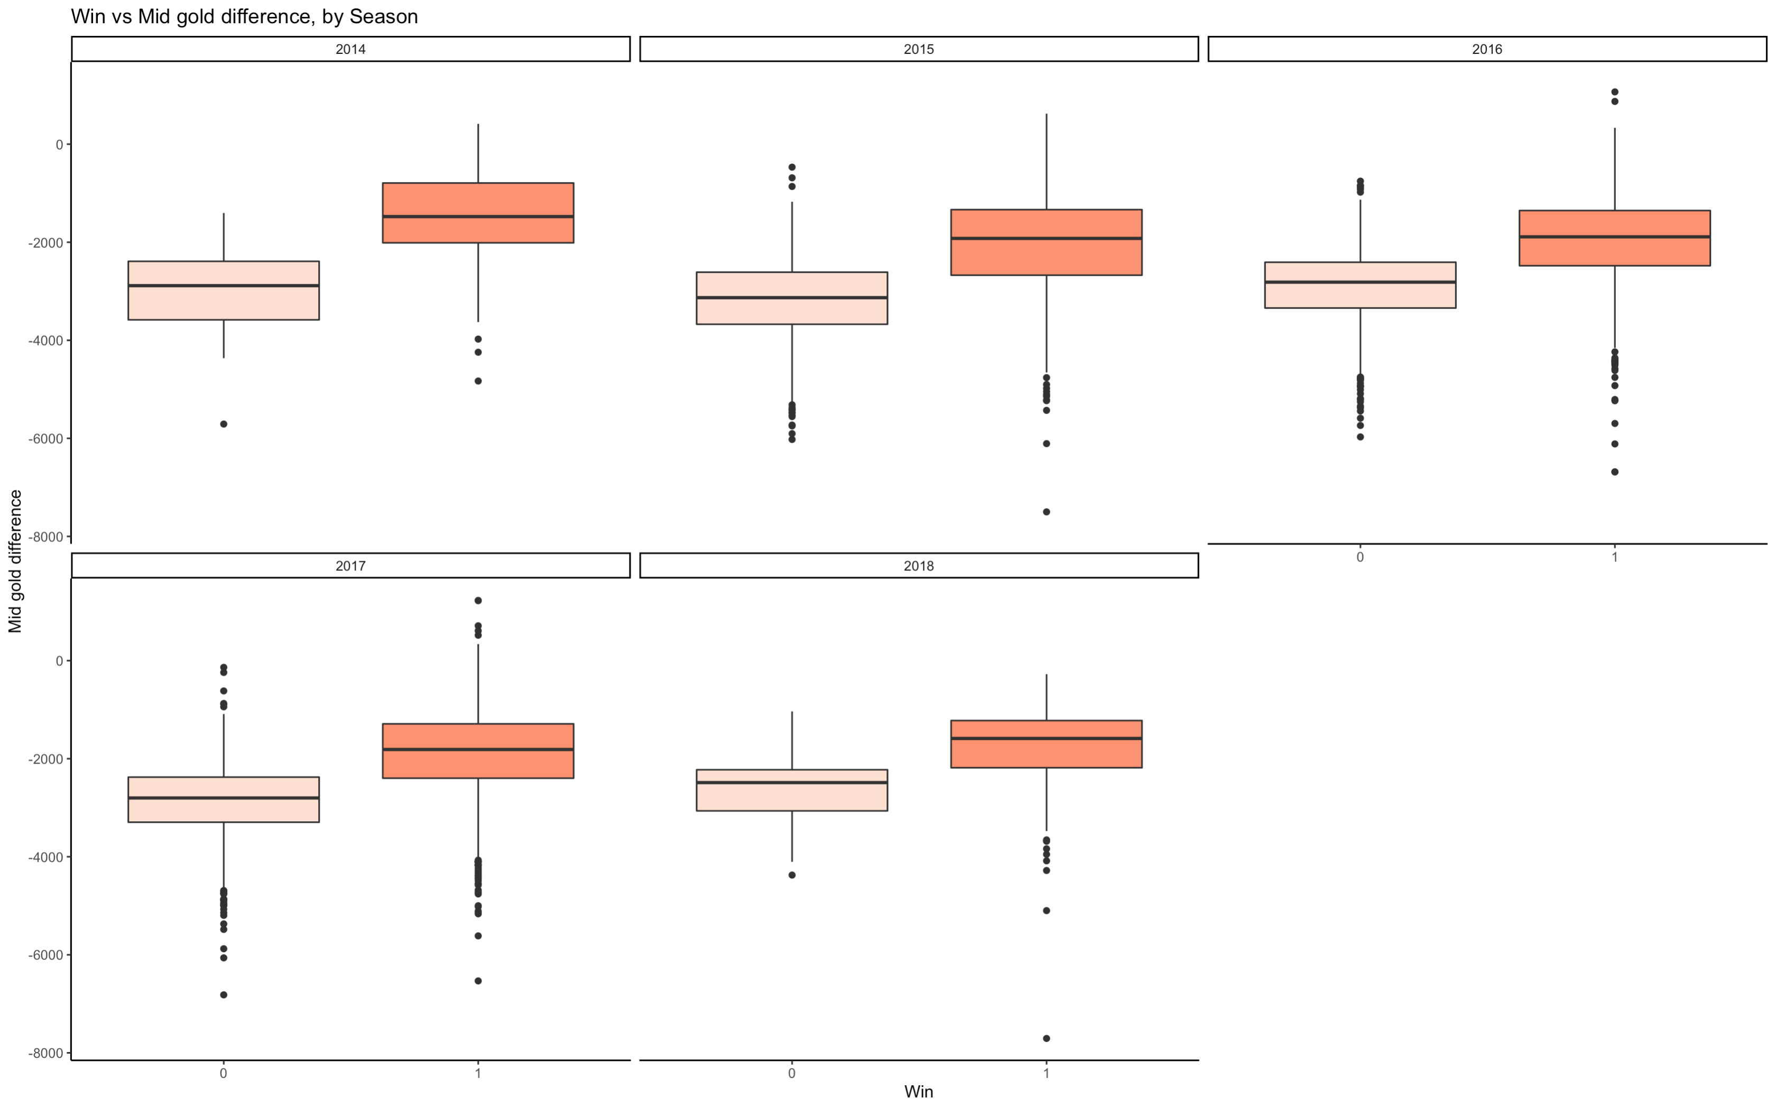
EDA
Numeric Variables
Categorical Variables

Slide 5
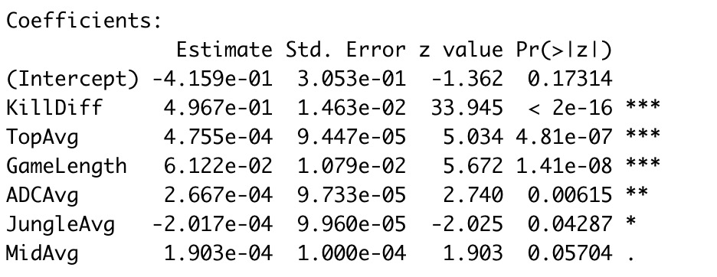
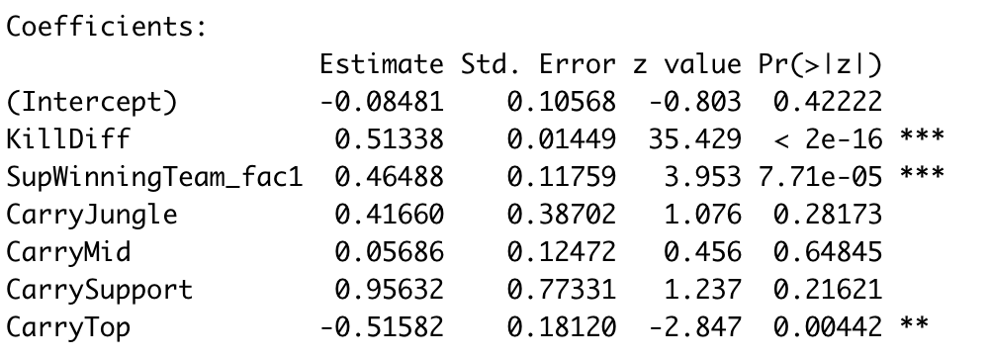
Model
win ~ KillDiff + TopAvg + GameLength + ADCAvg +
JungleAvg + MidAvg
win ~ KillDiff + SupWinningTeam_fac + Carry

Slide 6
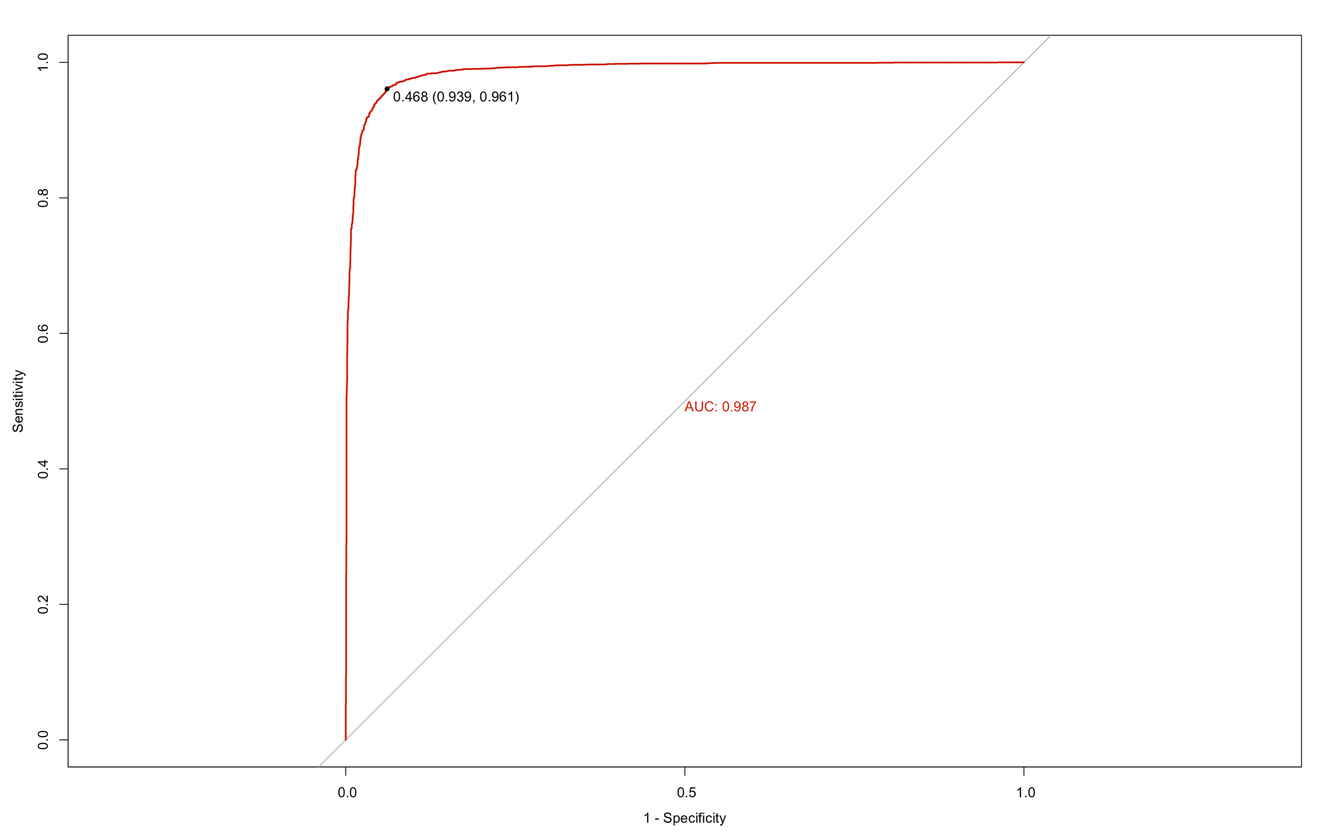
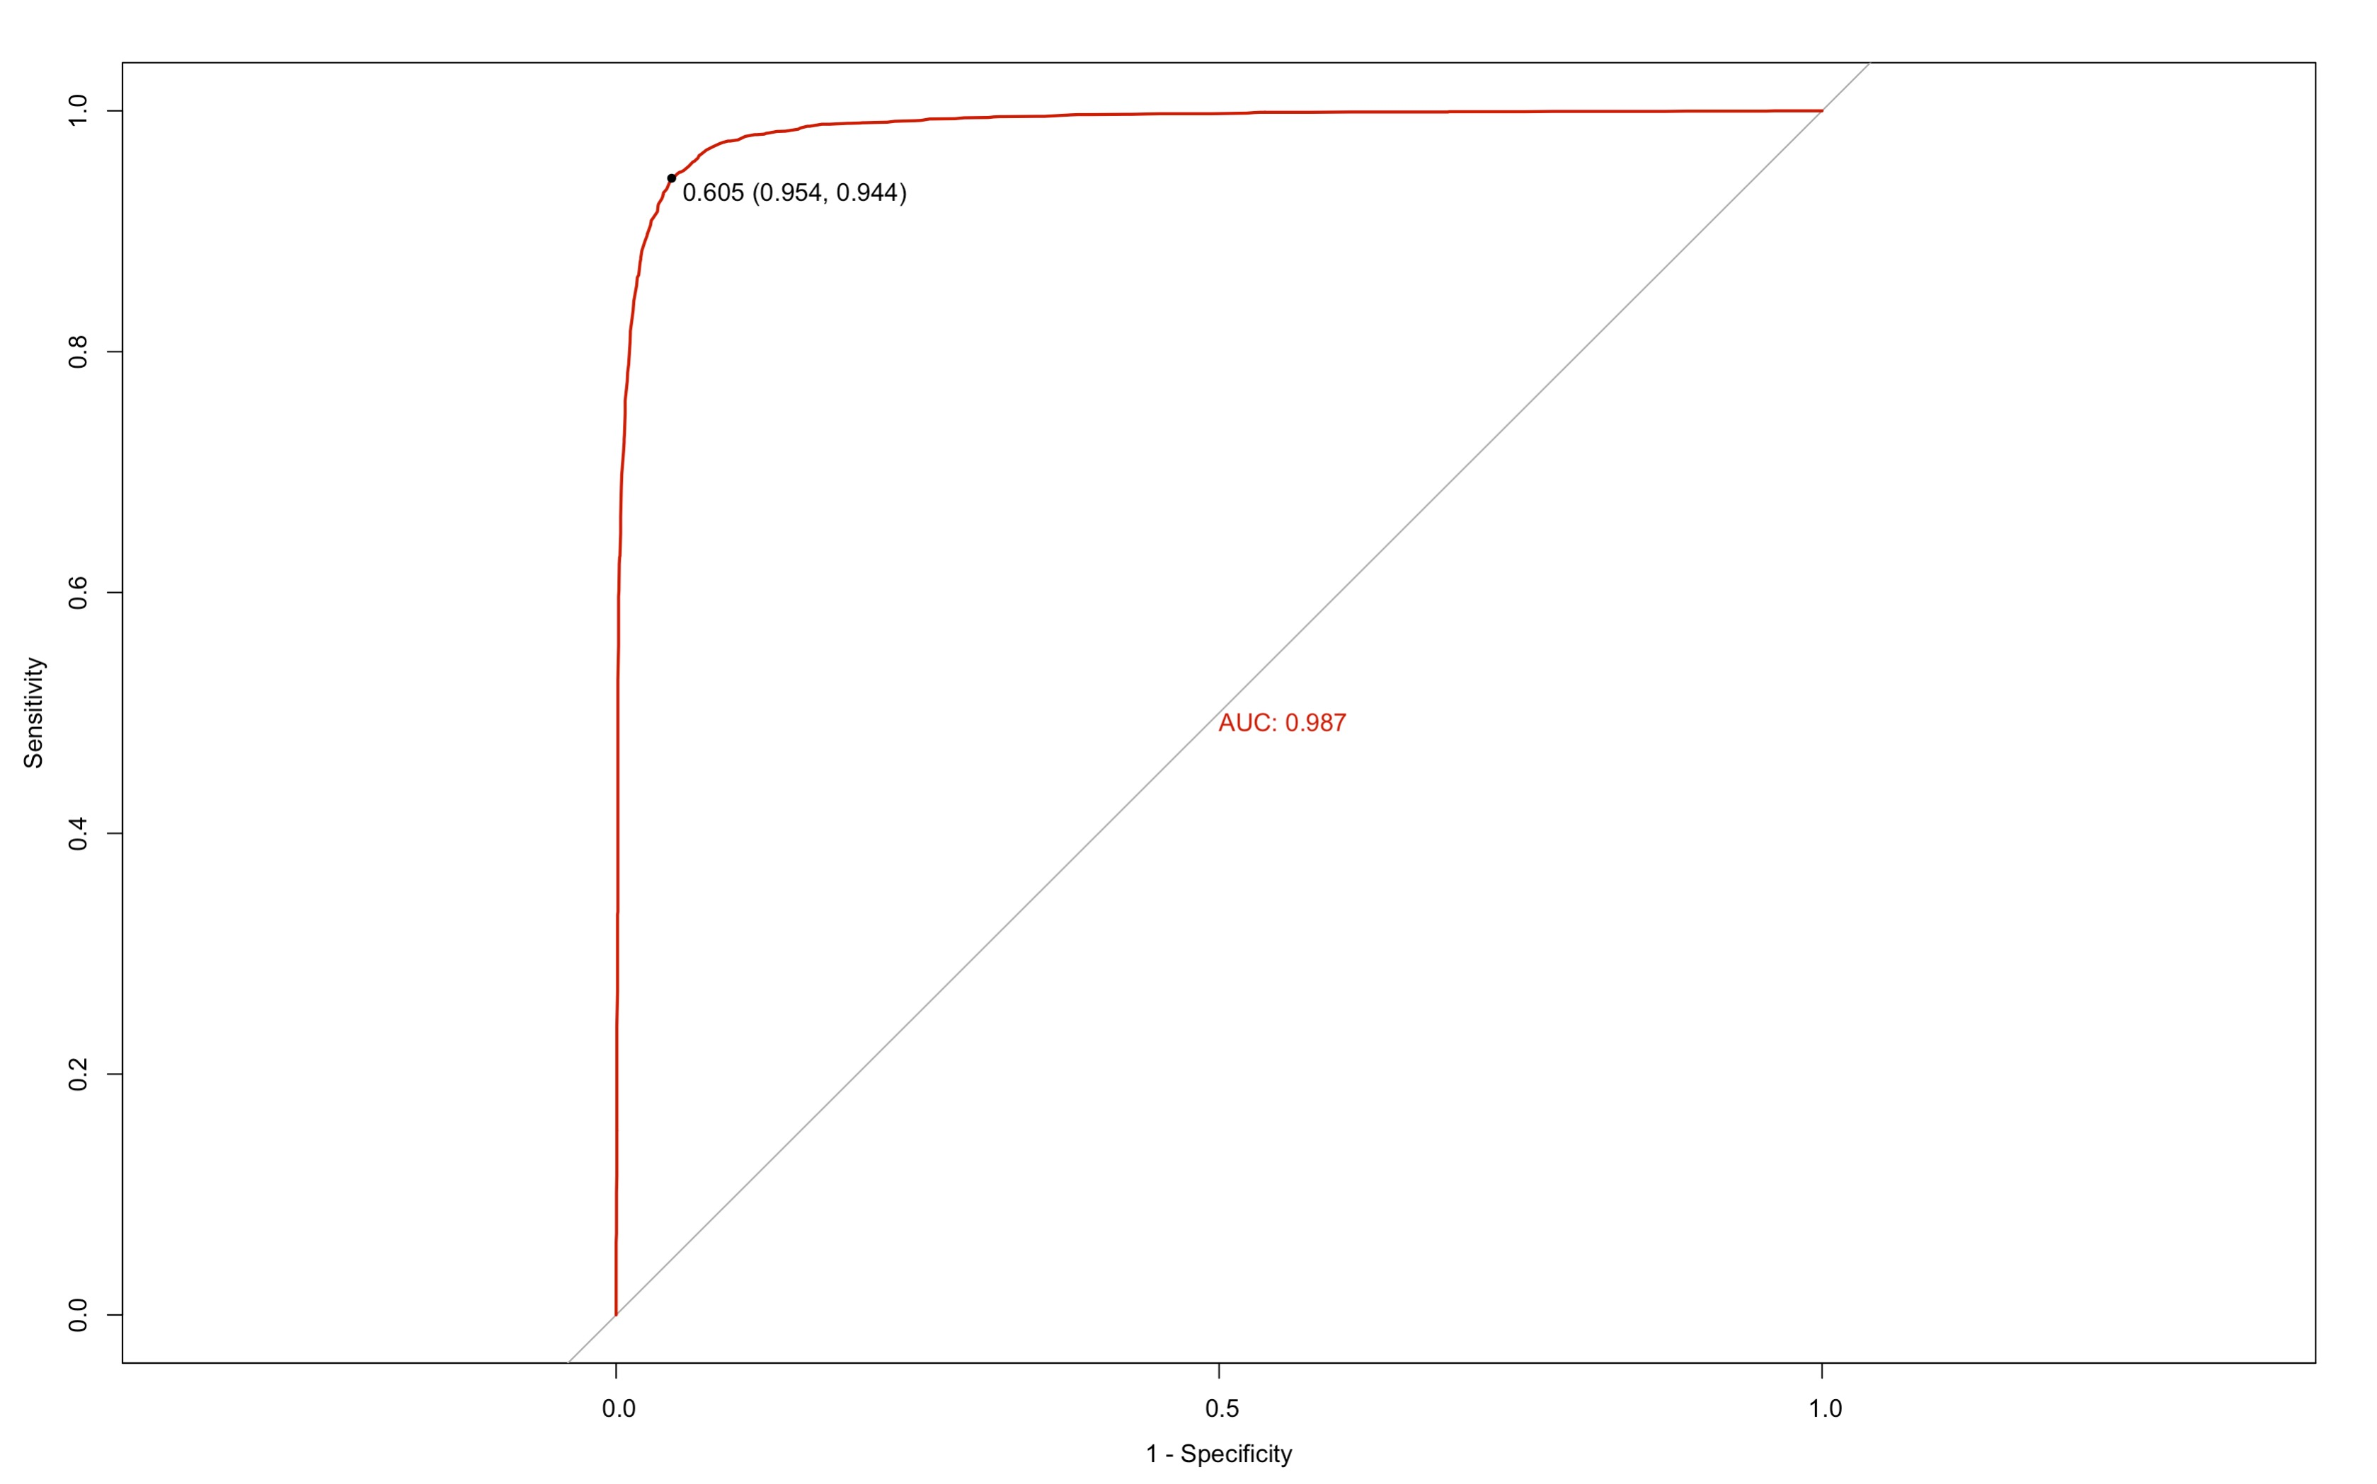
Model Validation
Model Selection: AIC Stepwise
Model Performance Metrics
Accuracy | Sensitivity | Specificity
0.949 | 0.955 | 0.942
Accuracy | Sensitivity | Specificity
0.948 | 0.949 | 0.946

Slide 7


Key Findings
64% increase in odds of win per increase in Kill
6% increase in odds of win per minute increase in Game Length
Mid and ADC plays an essential role in winning the game
Jungle will have negative effect on the winning of a game
67% increase in odds of win per increase in Kill
Categorical predictors are not significant except support
No interest interaction findings

Slide 8
Limitations
Inaccurate Data
Overfitting

Slide 9

Thank You For your time!

